Slide 1
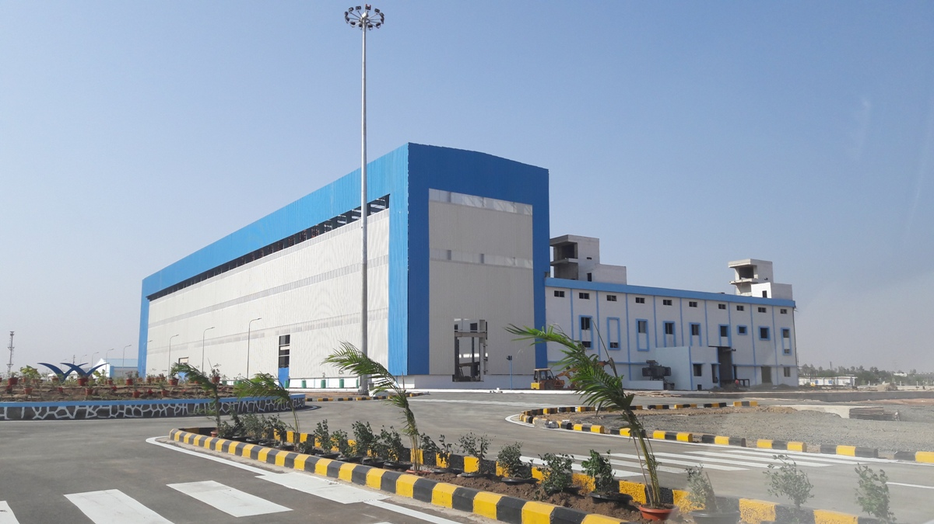

Welspun Post Campaign Evalution
Month: Oct-Nov

Slide 2

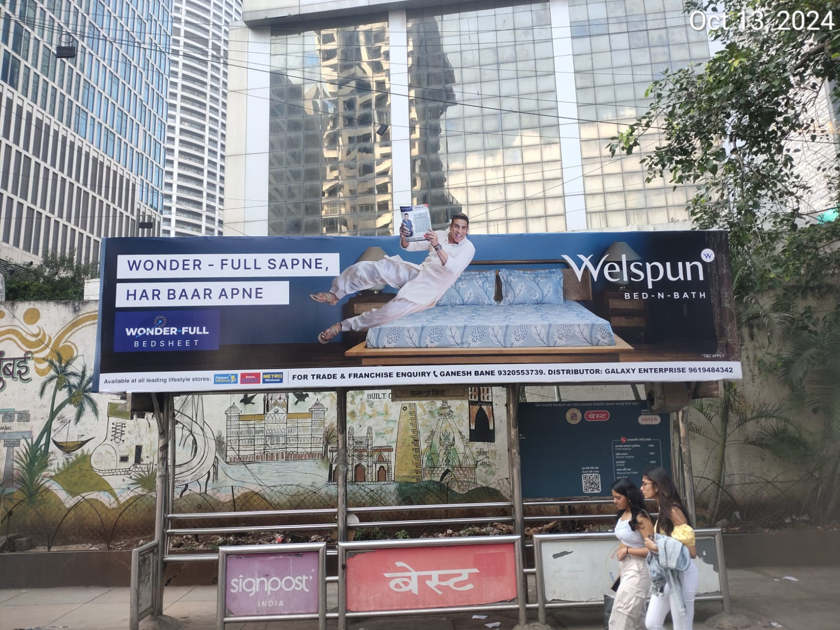
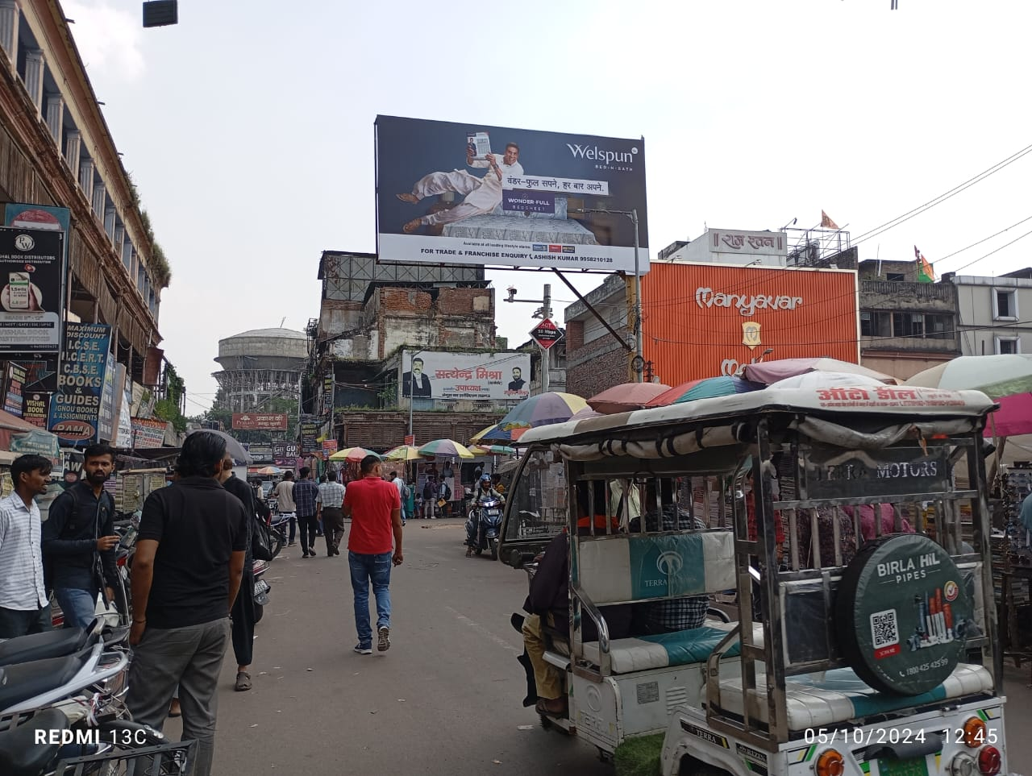
Creating pan-India Awareness across 17 Cities, with 164 Units in 22 days
Almost 46% High Impact Formats and remaining with reach medium
Impression in Mn : 128
Unique Reach in Mn : 10.27
Average Frequency : 12
Notes:
The campaign was executed across 17 cities, encompassing metro, Tier 2, and Tier 3 locations. Our primary focus was on large media formats, complemented by BQS and small media formats. Over the course of the 22-day campaign, we covered a total of 164 units.

Slide 3
City Level Campaign Evaluation
 | Town | Units | Impression | Unique Reach | Average Frequency
Metro | Mumbai | 46 | 3,65,00,333 | 26,35,403 | 14
 | Delhi | 37 | 3,47,37,136 | 23,39,201 | 15
 | Hyderabad | 11 | 94,67,213 | 9,15,591 | 10
 | Surat | 7 | 66,98,189 | 8,53,272 | 8
 | Bengalore | 8 | 56,24,291 | 7,44,939 | 8
 | Chennai | 5 | 52,59,493 | 6,23,163 | 8
Tier 2 | Jaipur | 9 | 77,32,598 | 7,54,400 | 10
 | Lucknow | 7 | 63,06,026 | 7,83,357 | 8
 | Ludhiana | 4 | 31,61,900 | 4,44,087 | 7
 | Varanasi | 4 | 30,14,565 | 3,61,459 | 8
 | Amritsar | 5 | 27,26,320 | 3,61,102 | 8
 | Visakhapatnam | 3 | 21,44,224 | 2,72,455 | 8
 | Coimbatore | 2 | 13,75,711 | 1,82,213 | 8
 | Mangalore | 2 | 8,01,091 | 1,09,140 | 7
 | Prayagraj | 1 | 7,54,053 | 1,02,732 | 7
 | Panipat | 1 | 4,39,046 | 57,019 | 8
Tier 3 | Udaipur | 2 | 8,04,840 | 1,08,032 | 7
Key Points: In metro cities, we reached 70% of the audience through 114 units.
In Tier 2 cities, we reached 29% of the audience utilizing 38 units.
In Tier 3 cities, we reached 5% of the audience with 2 unit.
The average frequency in metro cities is highest for Mumbai, Delhi, and Hyderabad.
The average frequency in Tier 2 cities is highest for Jaipur.
In Tier 3 cities, the average frequency is 7 for Jaipur.

Slide 4
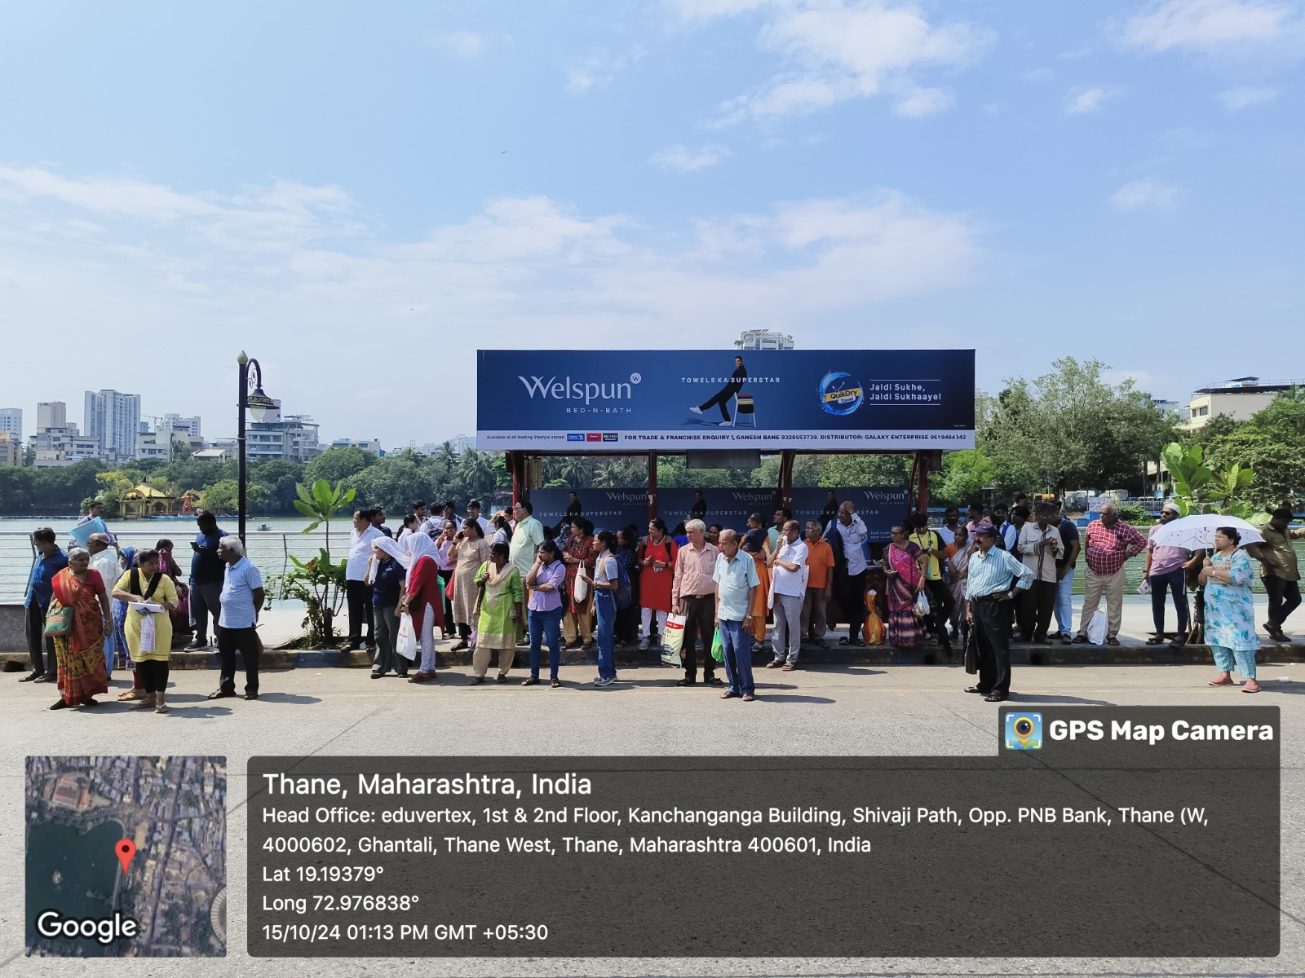
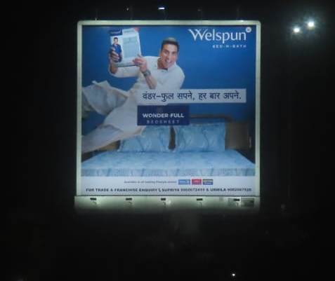
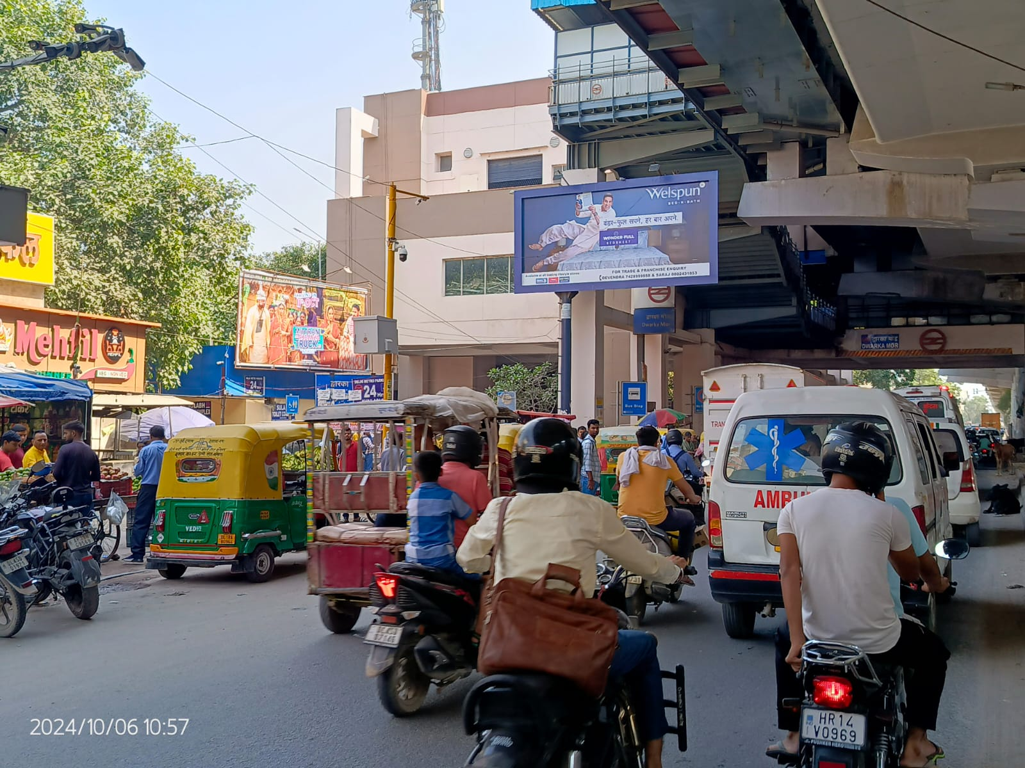
Campaign Executed Photos

